Slide 1
HCI
SQLite
Database
Sajjad Ali
Dr. Ahsanullah

Slide 2




Outline
Introduction
Process
Queries
Conclusion

Slide 3
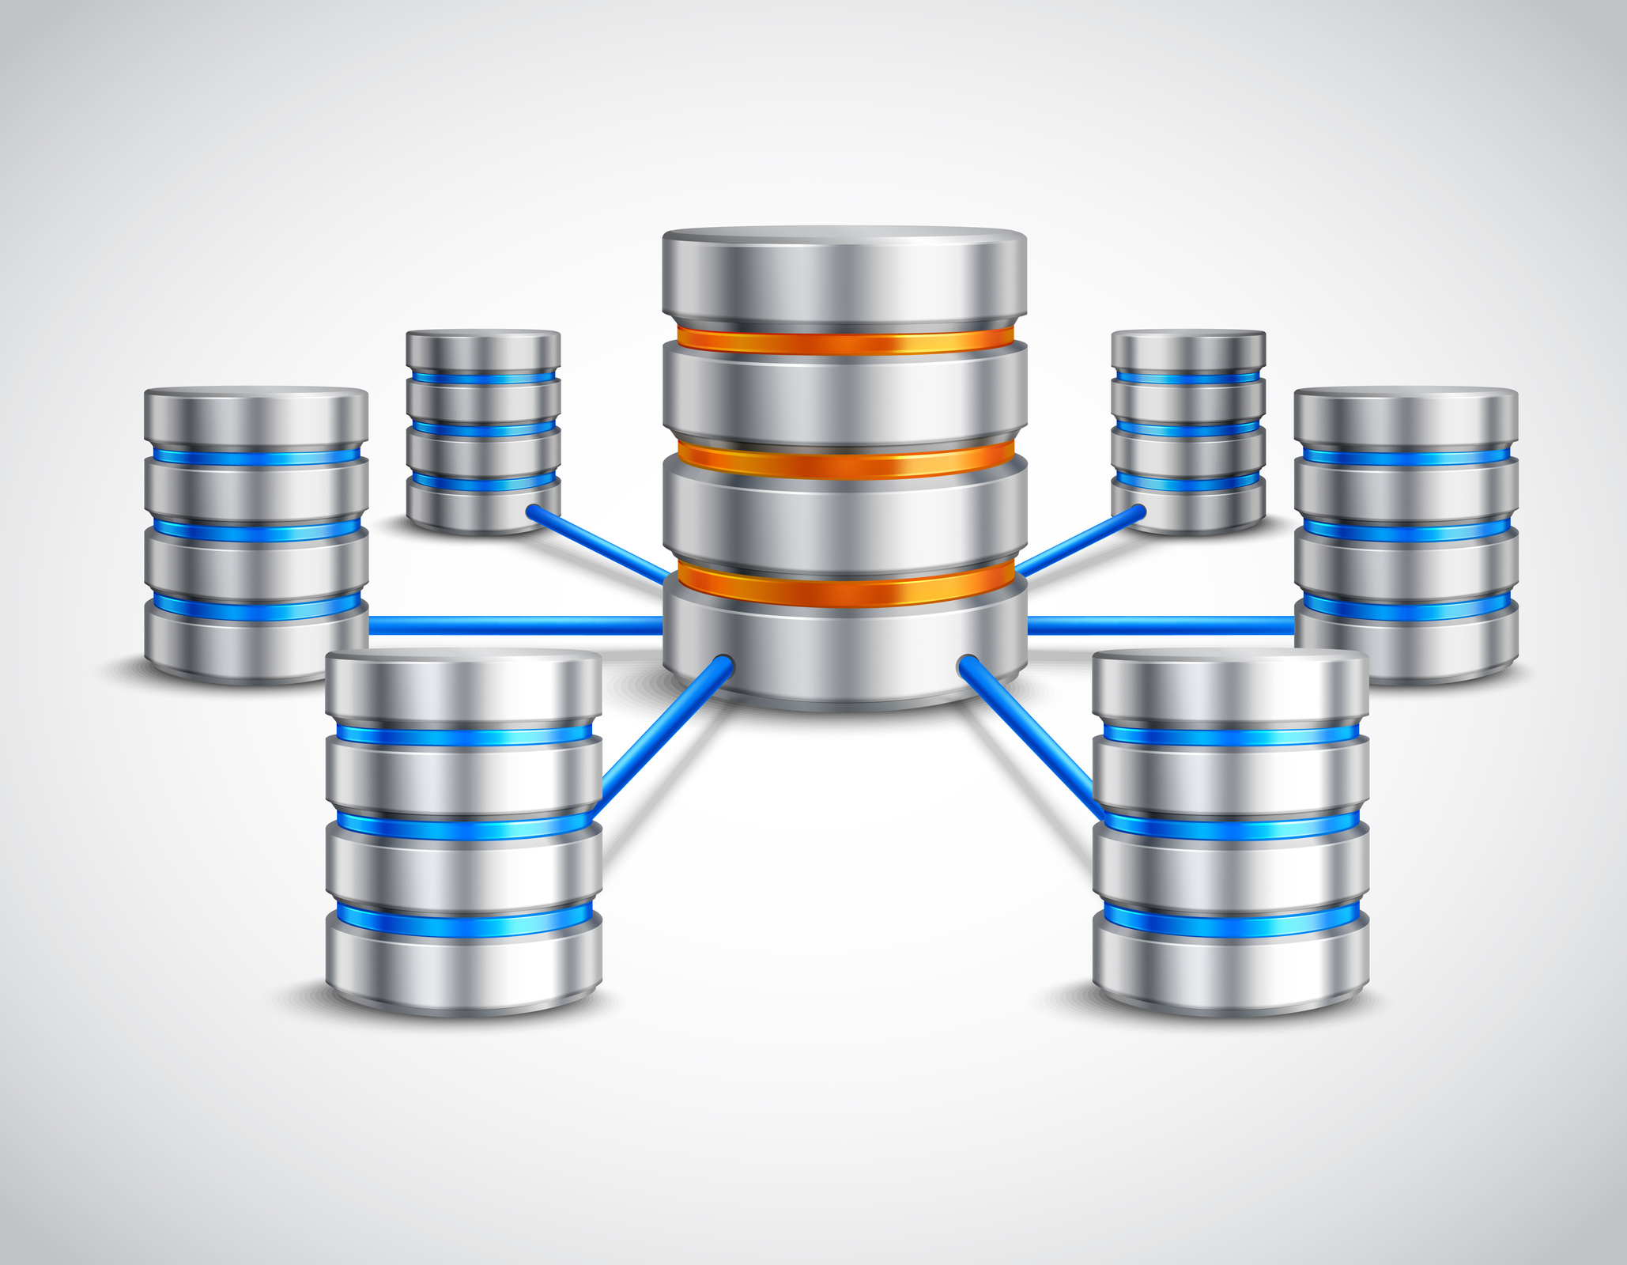
Introduction
C language library that implements SQL engine
Database
Process Insights

Slide 4



Introduction
Fast & Reliable
Stable & Cross Platform
Small & Lightweight
Features

Slide 5
Process
There are six general steps to work with SQLite database in python

Slide 6


1. Import module
code
import sqlite3
Python
Library

Slide 7

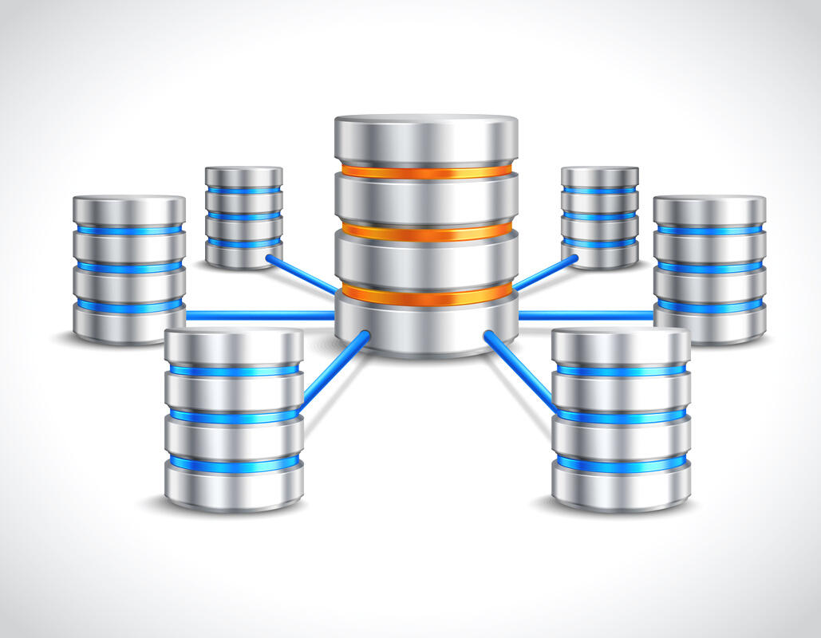
2. Create Connection
code
con = sqlite3.connect("users.db")
Connection
Database

Slide 8
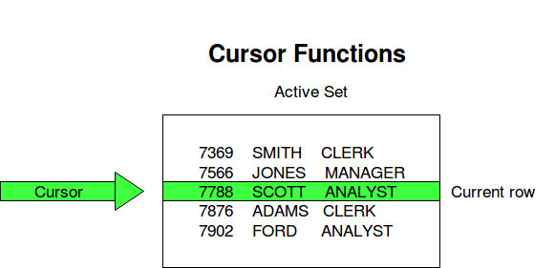

3. Create the cursor
code
cursor = con.cursor()
Cursor
Connection

Slide 9

4. Execute Queries
code in next section
Query
Cursor

Slide 10

5. Commit the changes
code
con.commit()
Commit
Connection

Slide 11

6. Close the Connection
code
con.close()
Close
Connection

Slide 12
Process
# Combined
import sqlite3
con = sqlite3.connect("users.db")
cursor = con.cursor()
# execute any number of quries
con.commit()
con.close()

Slide 13
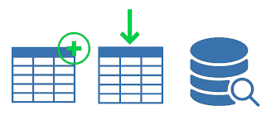


Queries
Create tables
Insert data
Read data
code sample
cursor.execute(query)

Slide 14
Create Tables
query =
"""CREATE TABLE user(first_name VARCHAR(20)
PRIMARY KEY,last_name TEXT ,age INT)
"""
cursor.execute(query)
first_name | last_name | age

Slide 15

Insert data
Insert one record at a time
cursor.execute(
"""INSERT INTO user(first_name, last_name, age)
VALUES ('Sajjad', 'Ali', 22)
""“
)
Database

Slide 16
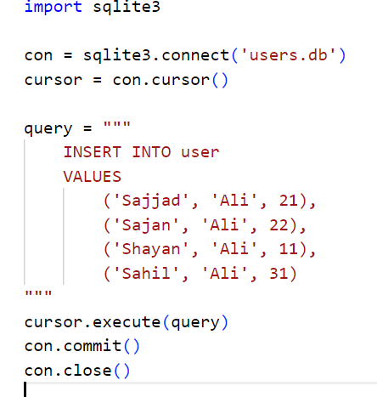
Insert data
Insert many records at a time

Slide 17
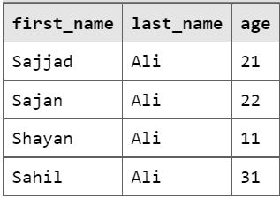
Read data
res = cursor.execute("SELECT * FROM user")
print(res.fetchall())

Slide 18
Conclusion
Let's just recap what we have
SQLite is a C language library
It is really fast, small, and highly reliable
Follow the six step process to work with SQLite
Import the sqlite3 module
Create the connection
Create the cursor
Execute the queries
Commit the changes
Close the connection

Slide 19
Thank You

